Slide 1


www.studymafia.org
Seminar
On
Rover Technology
Submitted To: Submitted By:
www.studymafia.org www.studymafia.org
Notes:
1
1

Slide 2
Content
INTRODUCTION
ROVER SERVICES
ROVER ARCHITECTURE
ACTION MODEL
ROVER CLIENTS
ROVER CONTROLLER
ROVER DATABASE
LOCATION SERVER
MULTI-ROVER SYSTEM
CONCLUSION & FUTURE WORKS
REFERENCES

Slide 3
INTRODUCTION
Location-aware computing involves the automatic tailoring of information and services based on the cur-rent location of the user.
To achieve system scalability to very large client sets, Rover servers are implemented in an action-based concurrent soft-ware architecture that enables fine-grained application-specific scheduling of tasks.

Slide 4
ROVER SERVICES
BASIC DATA SERVICES
TRANSACTIONAL SERVICES
MAP-BASED SERVICES
FILTER…
ZOOM….
TRANSLATE…

Slide 5
LOCATION-SENSING TECHNOLOGIES
COARSE GRAINED SYSTEMS
Accuracies on the order of meters.
Suitable for outdoor areas.
FINED GRAINED SYSTEMS
Accuracies on the order of centimeters.
Suitable for both (indoor and outdoor areas) with higher
accuracies.
SENSOR FUSION

Slide 6
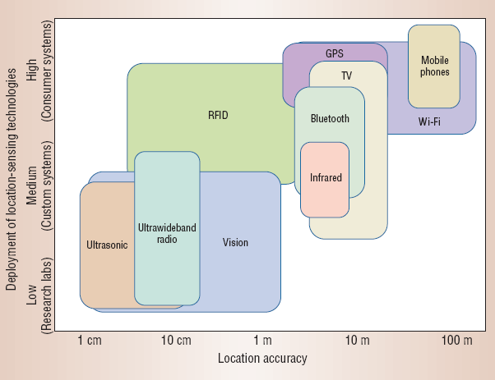
DEPLOYMENT OF LOCATION SENSING TECHNOLOGIES

Slide 7
ROVER ARCHITECTURE
End Users
Rover Clients
Wireless access infrastructure
Servers (manage and implements services provided to users)
Servers consists of the following :-
Rover Controller
Location Server
Media Streaming Unit
Rover Database
Logger

Slide 8
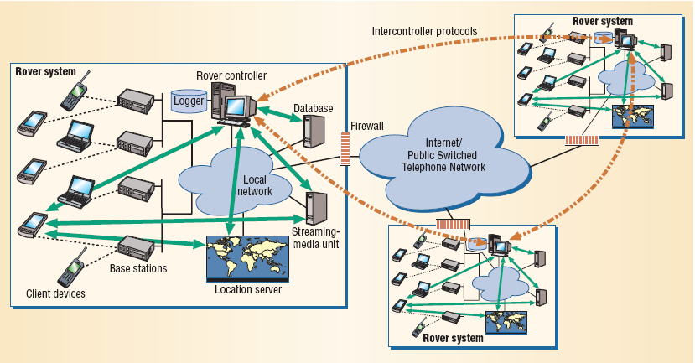
Physical architecture of Rover System

Slide 9
ROVER CONTROLER
Rover controller interacts with other components of the system through the following interfaces:-
Location Interface
Admin Interface
Content Interface
Back-end Interface
Server Assistants Interface
Transport Interface

Slide 10
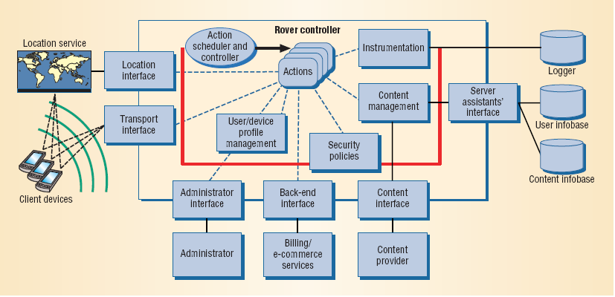
Logical architecture of Rover System

Slide 11
ROVER DATABASE
1) User info base:-
Maintains user and device info with
Volatile data and Non-volatile data
2) Content Info base:-
stores content served by the controller.
3) Transactions of rover controller with database from server operation are done by:-
lock-acquiring and blocking flags
for avoiding deadlock.

Slide 12
LOCATION SERVER
RADIO MAP TECHNIQUES
Works in 2 phases:
Offline phase.
Signal strength to vectors.
2)A location determination phase.
Vector sample compared with the radio-map.
MODEL BASED TECHNIQUES
Signal strength received from each access point is
transform in function of distance.

Slide 13
ACTION MODEL
Allows Rover systems to scale to large user populations by allowing real-time application specific scheduling of tasks.
Scheduling is done in atomic units called actions.
An action is a small piece of code
All actions are executed in a controlled manner by the Action Controller.
The action is executed whenever an I/O response is received.

Slide 14
SERVER OPERATION
ACTION MODEL
A SERVER OPERATION IS A SEQUENCE OF
ACTIONS.
Server operation refer to a transaction that
interacts with the rover controller.
Each server operation has exactly one
“response handling” action for handling
I/O event responses for the operation.

Slide 15
ACTION MODEL
SERVER OPERATION
A Server operation is in one of the following three states. They are:-
Ready-to-run: At least one action is eligible to be executed but no action is executing.
Running: One action is executing
Blocked: Server operation is waiting for some I/O response.

Slide 16
ACTION MODEL
ACTION CONTROLLER uses administrator defined policies for
scheduling of actions.
Management and execution of actions :-
Init(action id, function ptr)
Run(action id,function parameters, deadline failed handler
ptr)
Cancel(action id,cancel handler ptr):

Slide 17
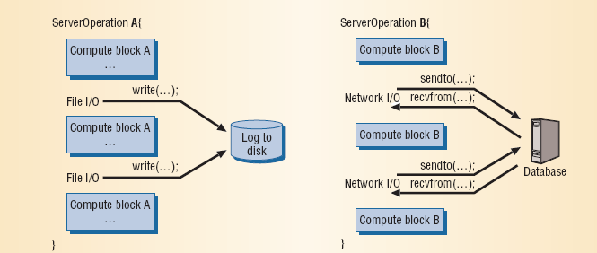
ACTION MODEL
ACTION VS THREADS
Our need to scale to very large client populations made us adopt the action model rather than the more traditional thread model.

Slide 18
MULTI-ROVER SYSTEM
The multi-rover system is a collection of independent rover systems that peer with each other to provide the seamless connectivity to the users.
The design of a multi-rover system is similar to the Mobile IP solution to provide network mobility to devices.

Slide 19
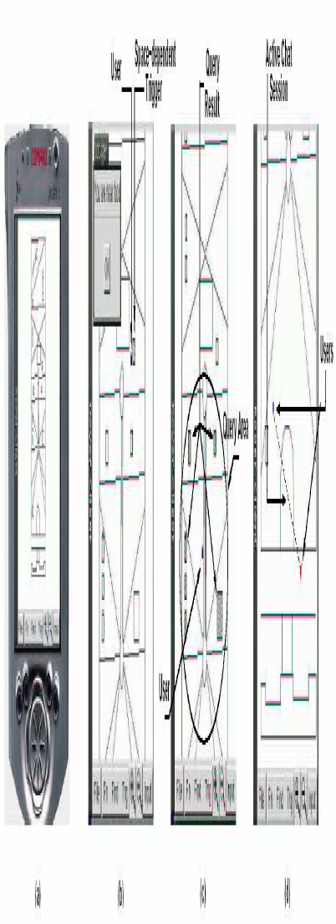
ROVER DEMO

Slide 20
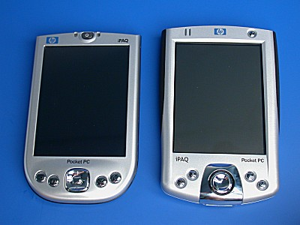
iPAQ Rover Client

Slide 21
Conclusion & Future Works
The short and long term projects of this paradigm:-
Experiment with limited capability devices
Location aware Streaming Devices
Interact with cellular providers and implement this mechanisms on cellular interface.
Multi-Rover System

Slide 22
REFERENCES
www.google.com
www.wikipedia.com
www.studymafia.org

Slide 23
THANKS

